Slide 1
Fake Job Prediction Mini Project
Group member: Liu Jikun, Dou Yuxiao, Lu Jingjun, Tang Yiyao
08/11/2020

Slide 2
Outline
01.
Exploratory Data Analysis and observations
(By Dou Yuxiao)
02.
TF-IDF
(By Liu Jikun)
03.
Prediction models
(By Lu Jingjun)
04.
Tackling imbalanced data & Word Embeddings
（By Tang Yiyao）

Slide 3
The Exploratory Data Analysis and observations
1
Checking Data types and visualizing by Catplot

Slide 4
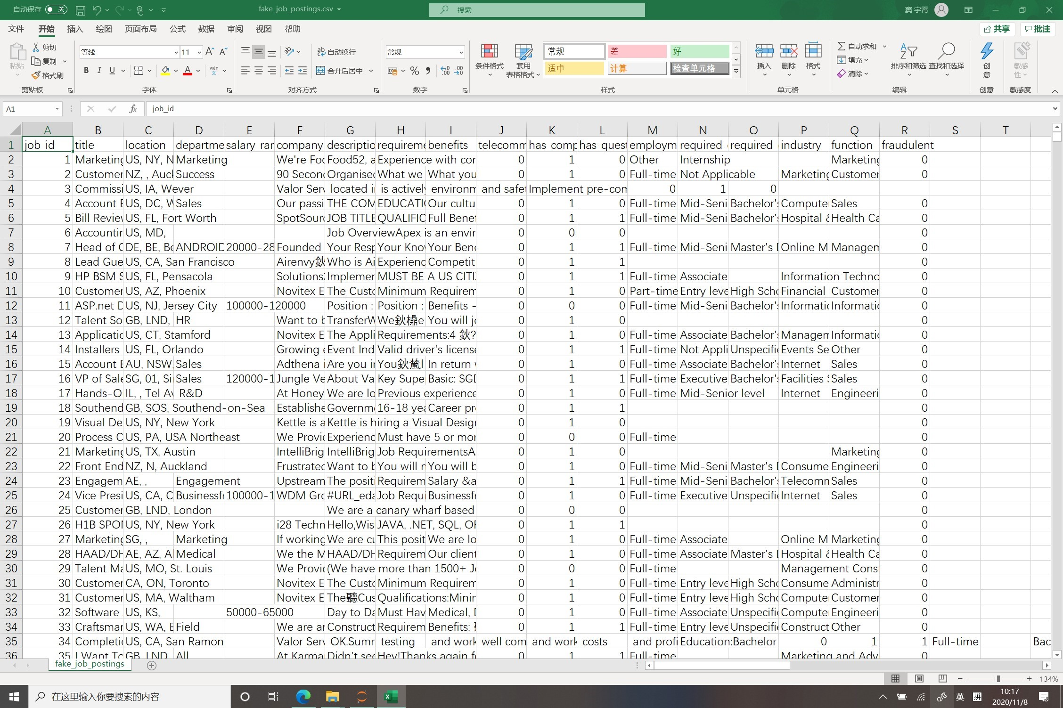
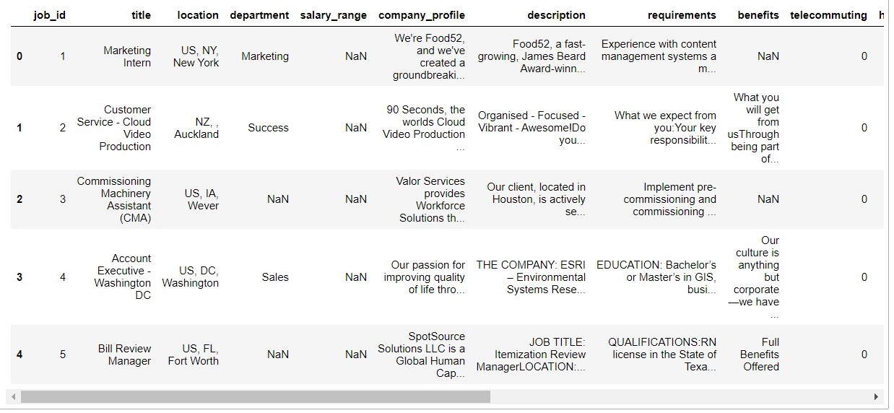
1
The Dataset
17000+ real jobs
800+ fake jobs

Slide 5
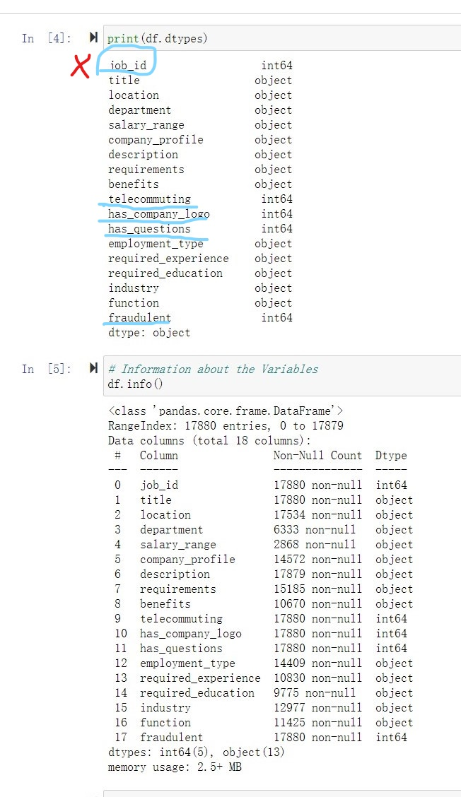
2
Data Analysis and observations
Textual(6 columns): company_profile, description, requirements, benefits
Categorical(11columns): employment_type, required_experience, required_education, industry, function，Location ,telecommuting, has_company_logo, has_questions,
Label(1 column)
Fraudulent

Slide 6
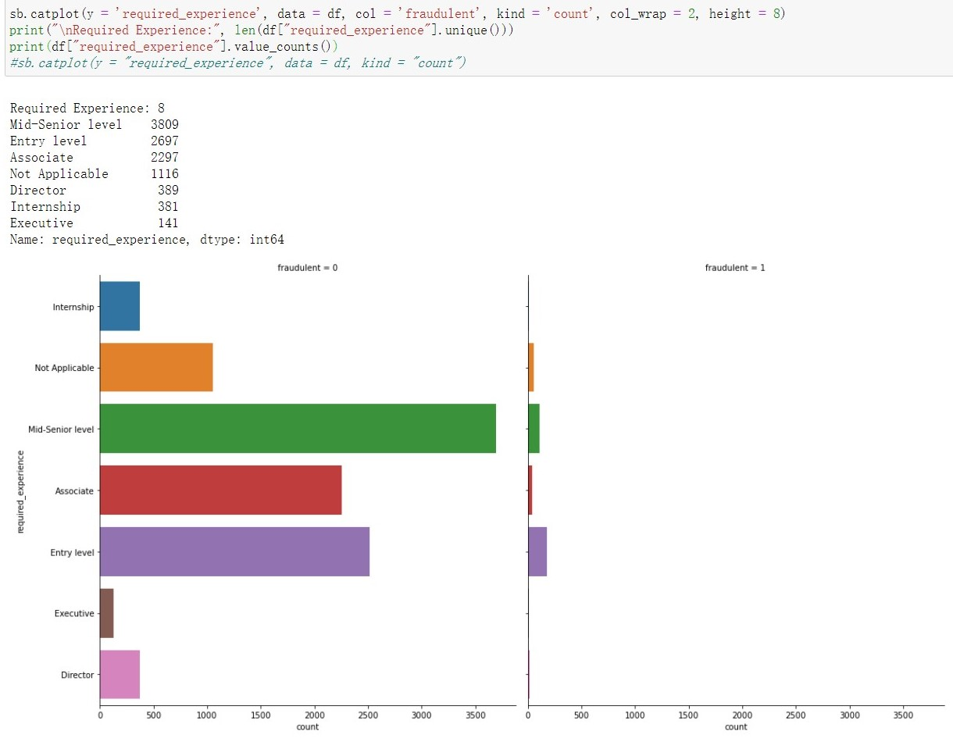
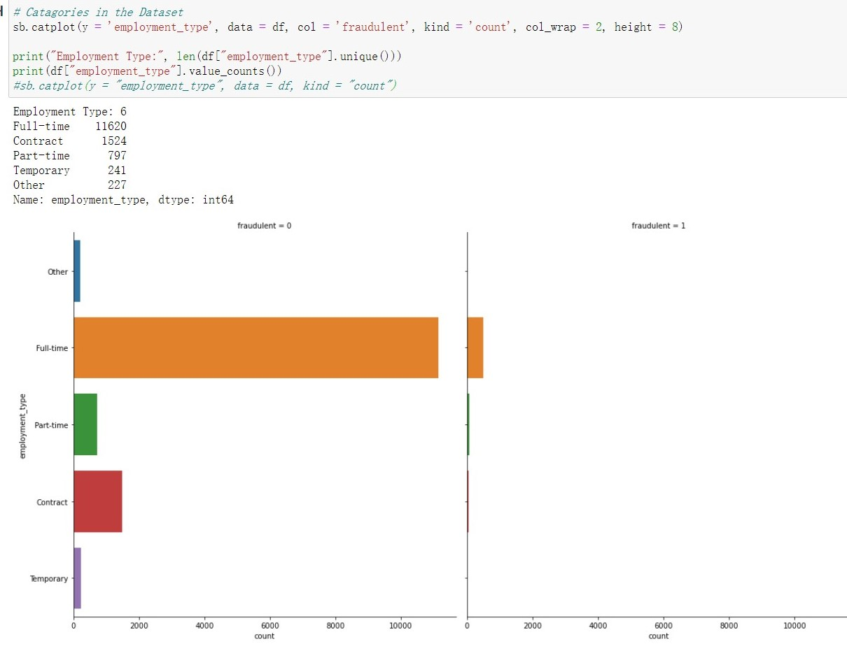
3
Required experience
Category data
Employment types

Slide 7
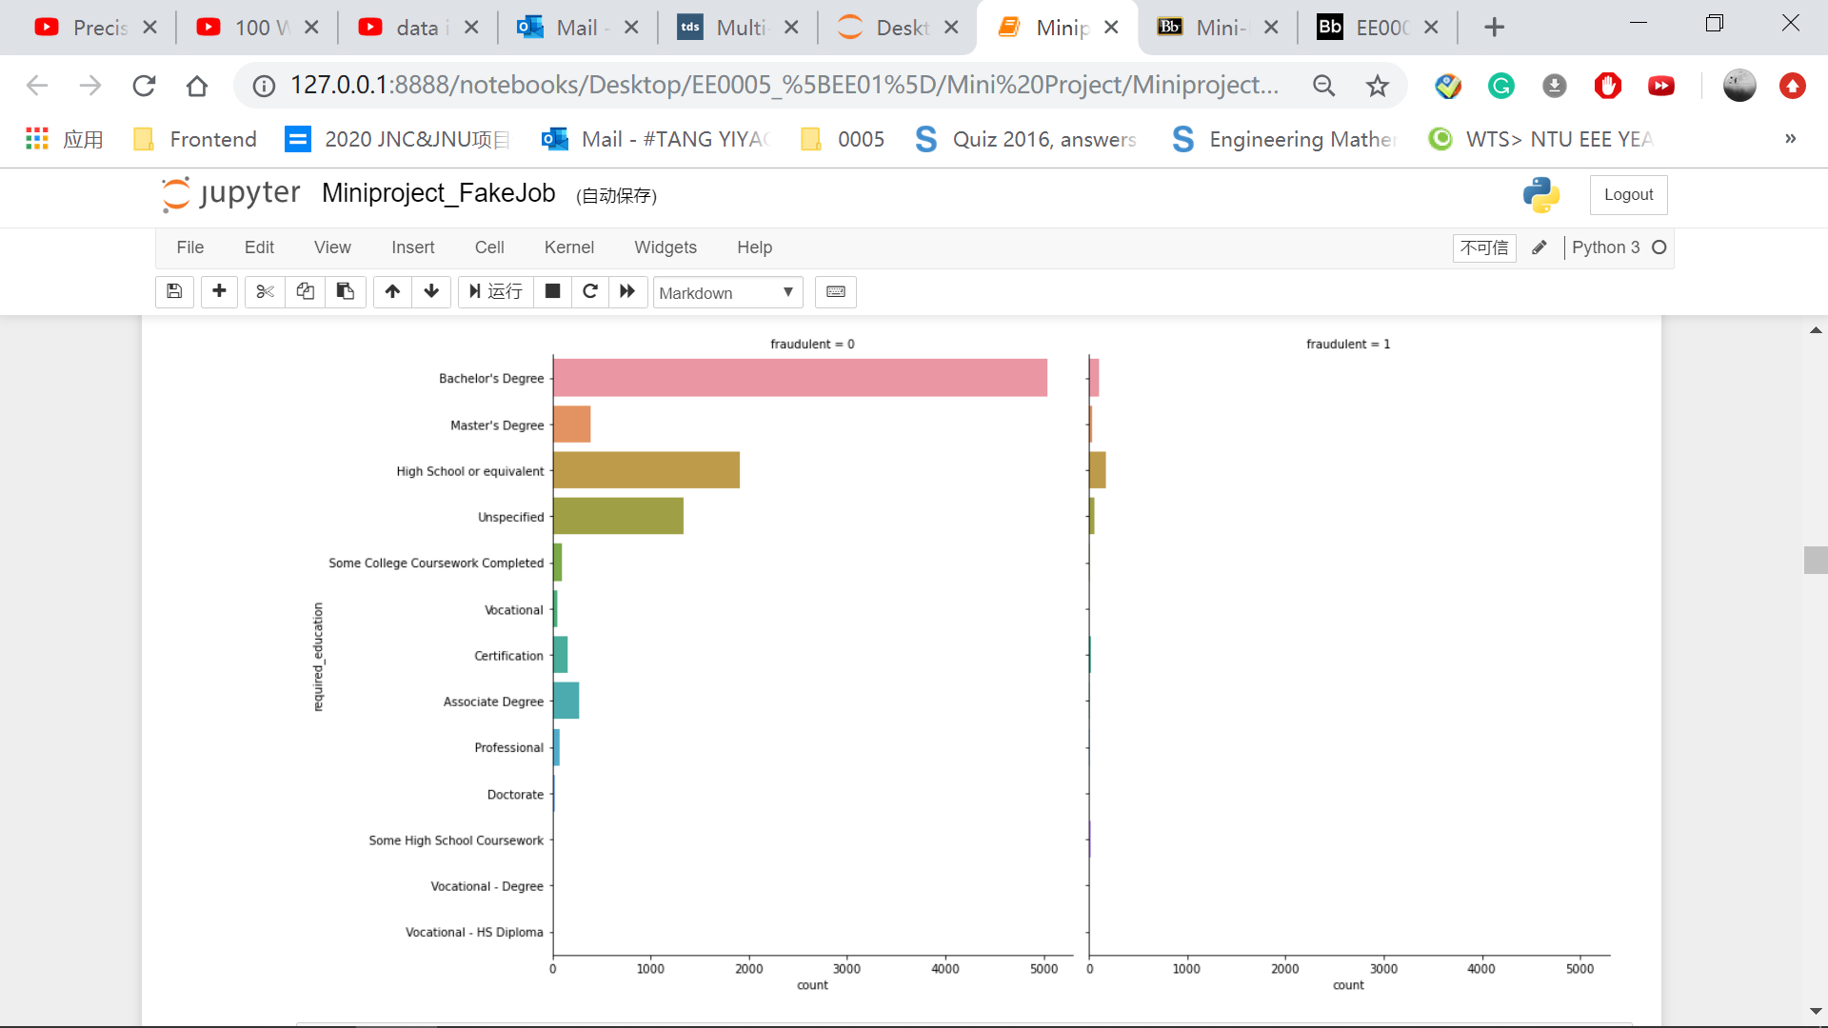


Slide 8
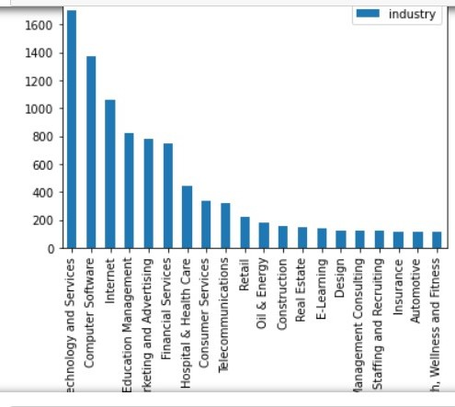
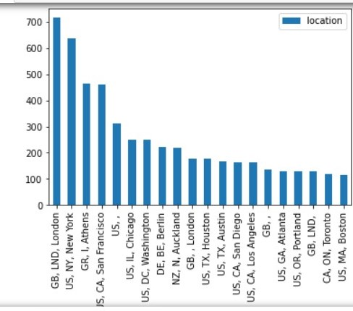
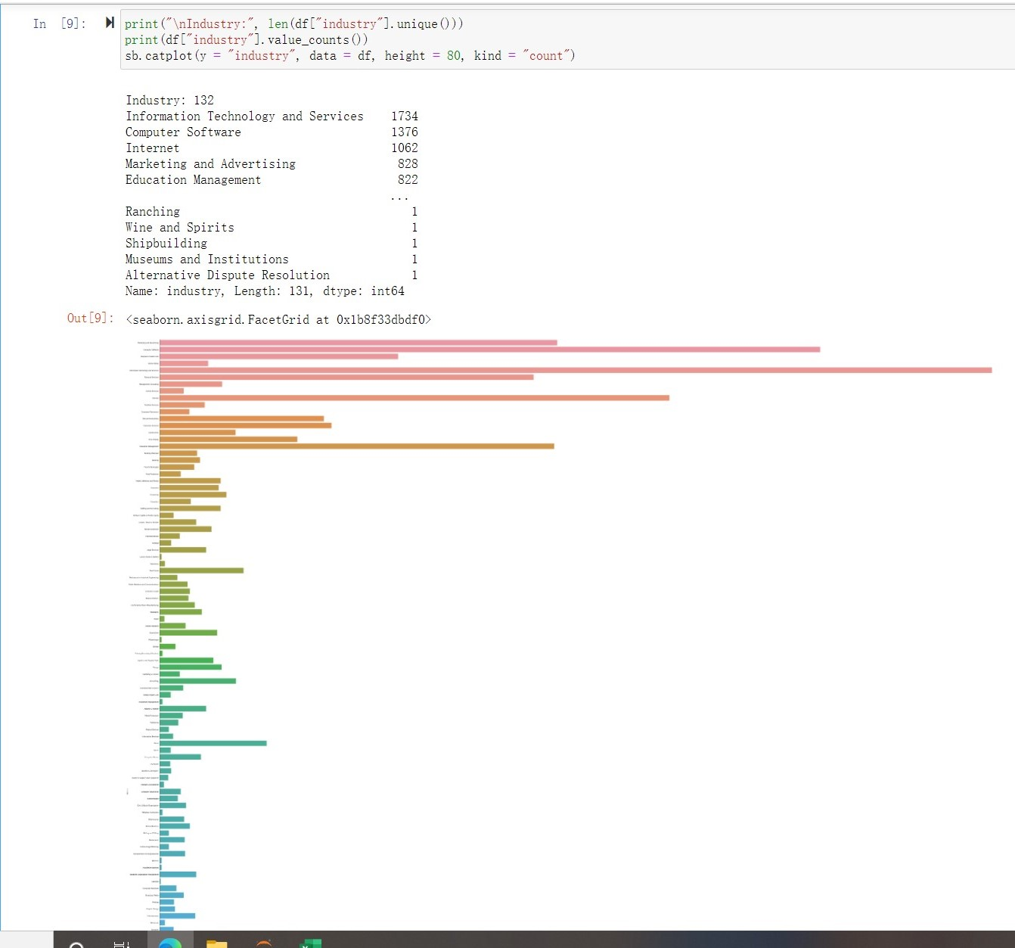
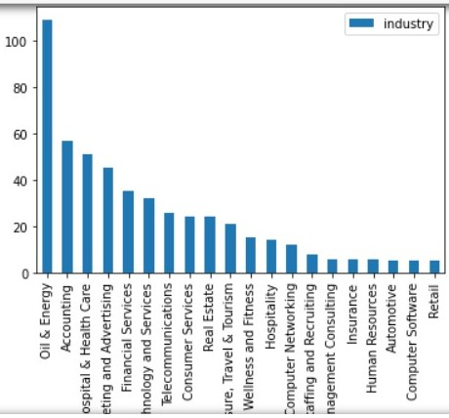
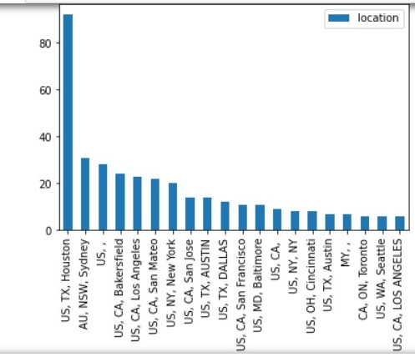
4
Category with too many unique values
Only the first 20 values are taken
Industry
Location
All real jobs
All fake jobs

Slide 9
Preparation: TF-IDF
2
We will use TF-IDF method to deal with natural language data for training the model.

Slide 10
1
TF-IDF
Explanation of the formula.
TF-IDF
TF: Term Frequency
IDF: Inverse Document Frequency
01.
How often the word appears in the text. TF(x) is just numbers of appearing divided by total word count
02.
The inverse value of how often the word appears in all kinds of documents.
Calculate IDF Value
Calculate TF Value
03.
IDF(x) = log((N+1)/(N(x)+1))+1
Here N is documents in the corpus.
N(x) is documents where the word appears.
04.
TF-IDF(x) = TF(x) * IDF(x)
We get the TF-IDF value.

Slide 11
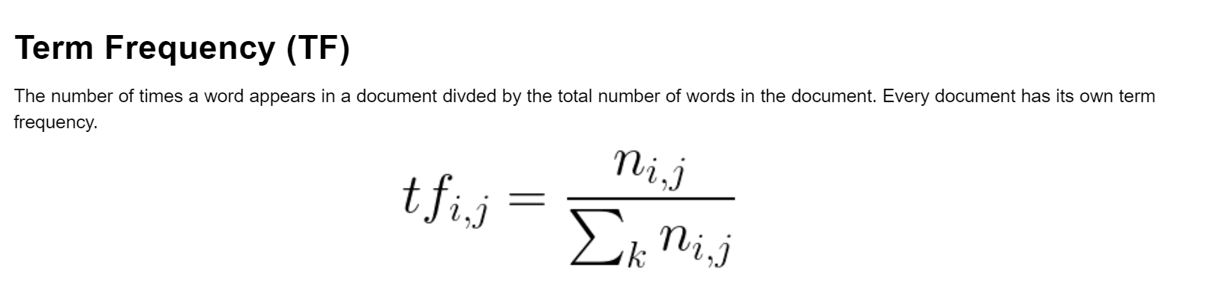
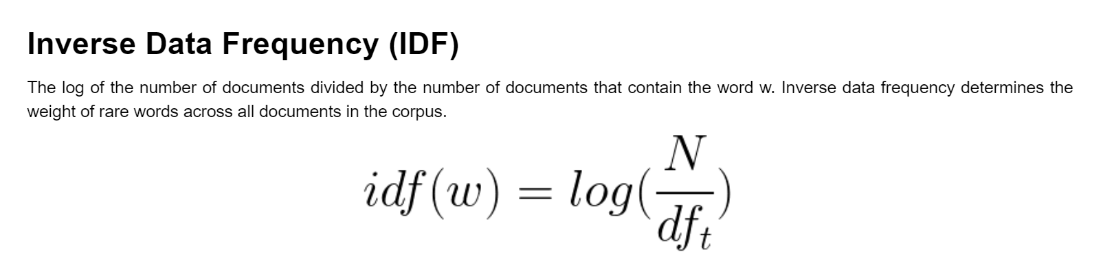
1
TF-IDF
Explanation of the formula.

Slide 12
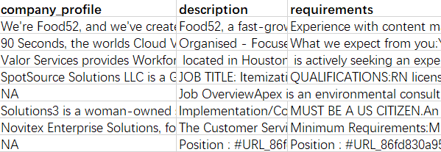
2
Select Columns
Choose useful columns which have features.
Choose columns like title, company_profile, description, etc.
Fill “” into NA cell in order to extract some features.

Slide 13
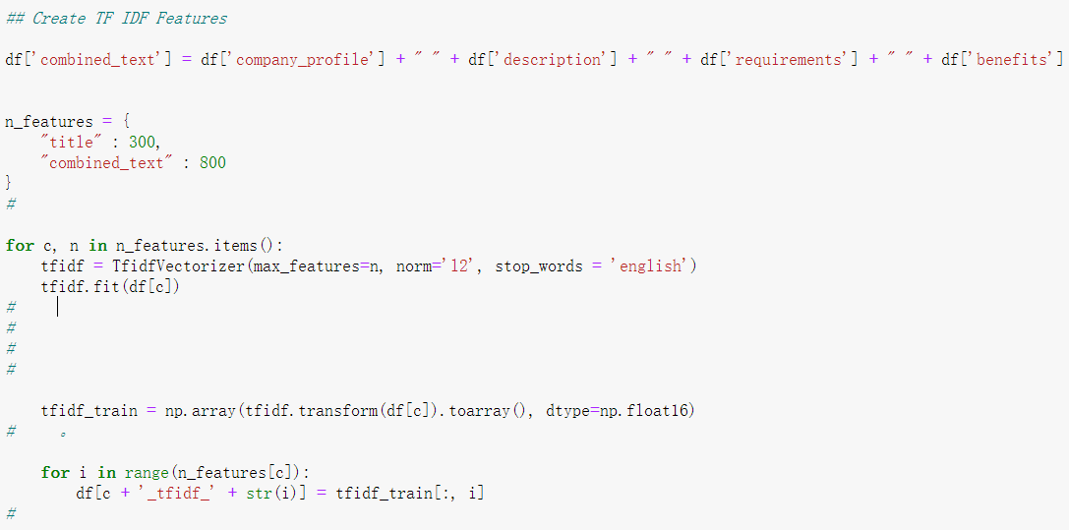
3
Create Features
Create columns which have features.
We treat these texts as combined texts to find features of them.
Set objectives: 300 features for titles and 800 features for combined texts.
We use the corpus ‘English’ to avoid some ordinary words.
Lastly, we transform TFIDF matrix into arrays and add new features columns into it.

Slide 14
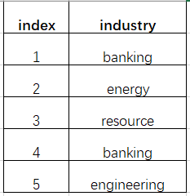
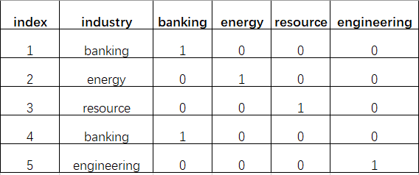
4
Dummy Indicators
Create dummy indicators from some data.
As there are many different value for data like employment type, industry, function, etc. We are going to call them categorical columns.
We would like to create dummy indicators for each value of these data and encoded them as columns to the end of the data frame.

Slide 15
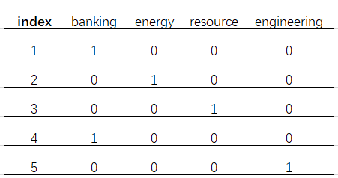
5
Drop Columns
Drop unnecessary columns
Drop unnecessary columns like title, department, salary range, industry, etc.
This is because some of them have been turned into TF-IDF features, some of them have been transformed into many indicators, some should have nothing to do with fraudulency.

Slide 16
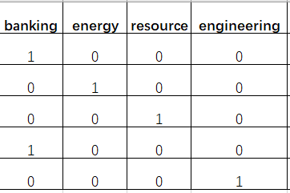
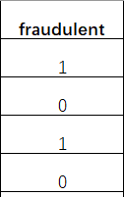
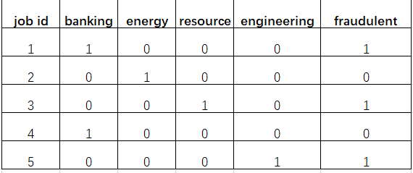
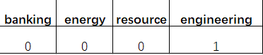
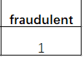
6
Build Model
Establish the train and data sets
We divide the data frame into two parts, one is all the features of each job advertisement and the other is its fraudulency.
The train_test_split function helps us to divide the dataset into train set and test set randomly with a ratio of 4:1. We name the split sets as original sets.

Slide 17
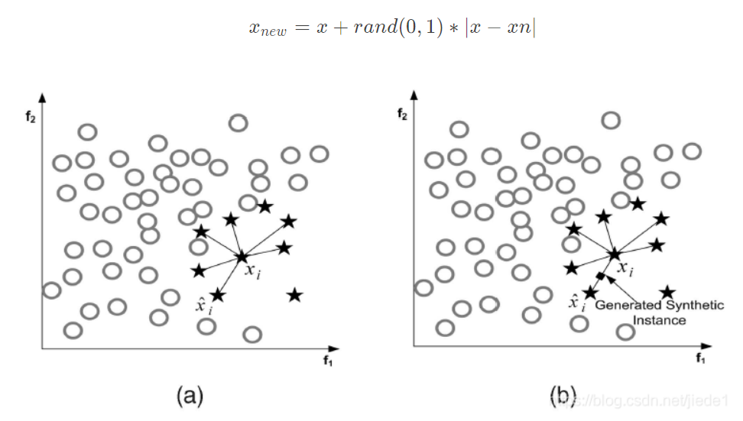
7
Oversampling
Deal with the imbalanced dataset using Synthetic Minority Oversampling Technique
As the data is imbalanced with fraudulent jobs only around 800 but 17000 true jobs, it is so easy to have accuracy up to 95% to tell a fraudulent job from true ones. In this case, the false positive rate is crucially important. To improve this, we are going to oversample the fraudulent jobs data in the train set. We raise real and fake jobs to the same amount here by SMOTE.

Slide 18
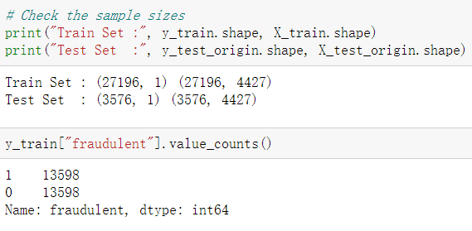
8
Build Model
Establish the train and data sets
In this way, the sample sizes are determined:
Train set: X_train(27196, 4427), y_train(27196, 1)
Test set: X_test_origin(3576, 4427), y_test_origin(3576, 1)

Slide 19
Model 1: Classification Tree
3
We will use binary classification to predict the result

Slide 20
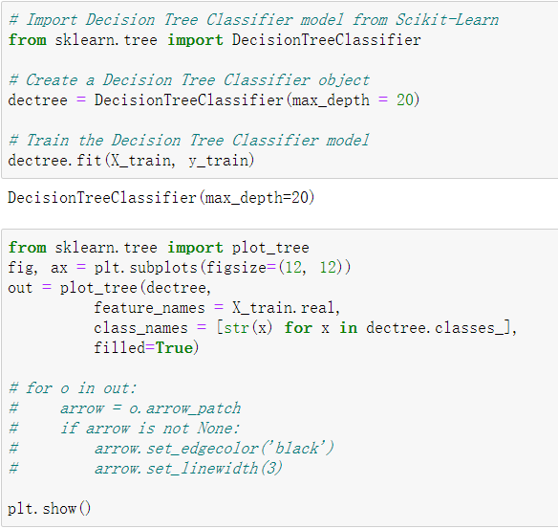
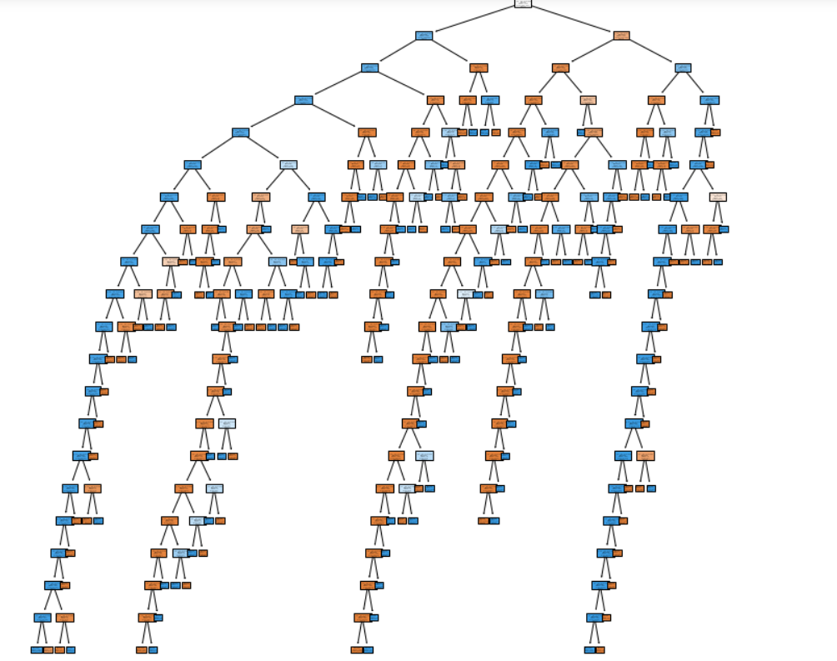
1
Decision classification tree
Max_depth = 20

Slide 21
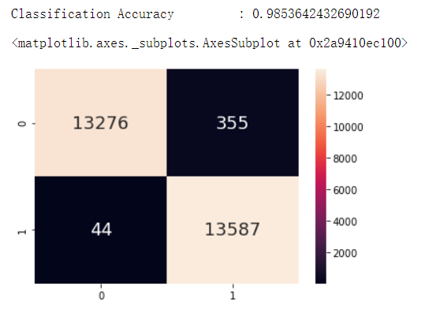
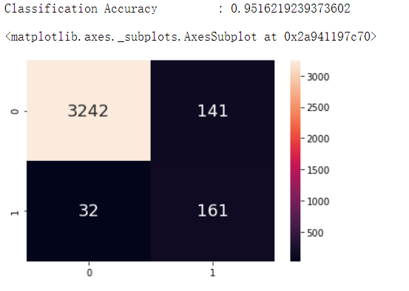
2
Decision classification tree accuracy
Max depth = 20
Train accuracy = 0.985364
Test accuracy = 0.951621
Train TPR=0.996772
Test TPR=0.834197

Slide 22
Classification: logistic regression & neural network
3
Using logistic regression and neural network models to do classification on the preprocessed job posting dataset

Slide 23
CONTENTS
01.
02.
Classification model 3:
Neural network
Classification model 2:
Logistic regression

Slide 24
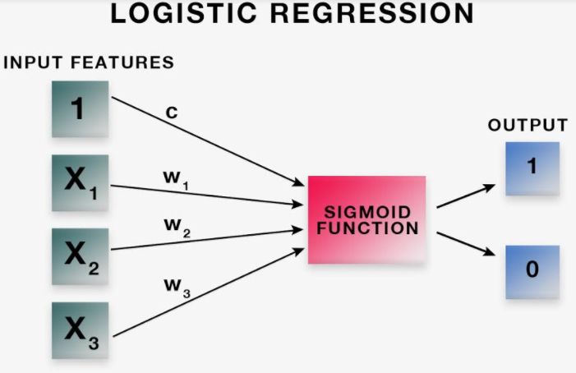
1
Logistic Regression
Classification method 2: Logistic regression
X_train size: (27196, 4427) X_test size: (3576, 4427)
y_train size: (27196, 1) y_test size: (3576, 1)
Max iteration times: 5000
Train accuracy: 94.6%
Test accuracy: 93.5%

Slide 25
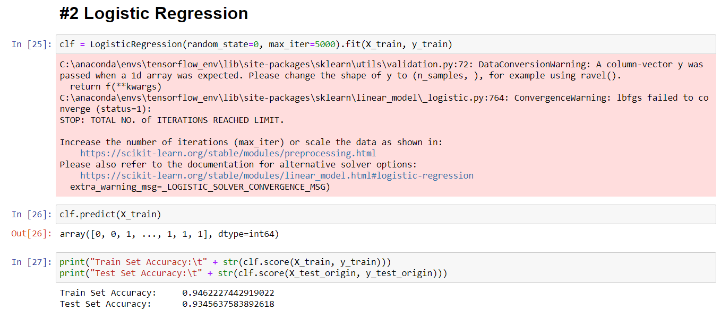
1
Logistic Regression

Slide 26
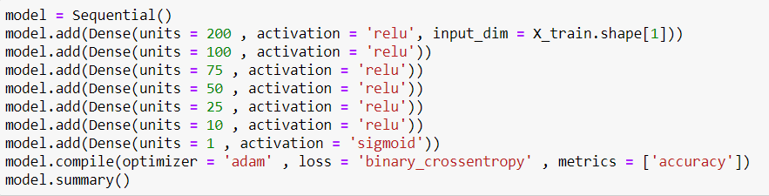
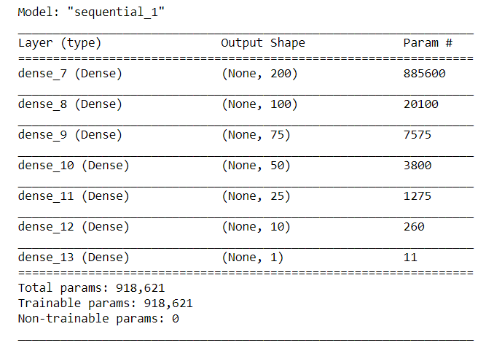
2
Neural Network
Classification method 3: Neural network
8 dense layers (6 hidden layers)
X_train size: (27196, 4427)
X_test size: (3576, 4427)
y_train size: (27196, 1)
y_test size: (3576, 1)
Model summary:

Slide 27
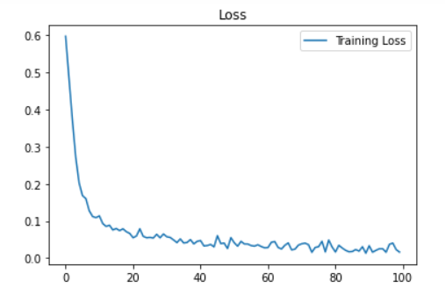
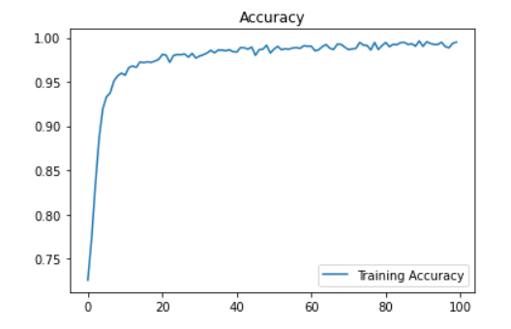
2
Neural Network
Neural network training
100 epochs (training curve already converged)
Train accuracy: 99.5%
Test accuracy: 98.3%
Visualization:

Slide 28
Tackling imbalanced data & Word Embeddings
4

Slide 29
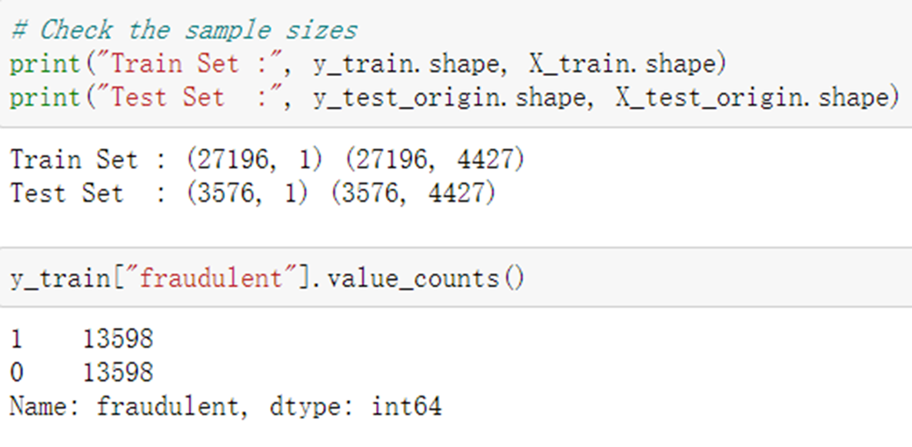

Question:
Why is the train set expanded?
17880 v.s. 27196

Slide 30

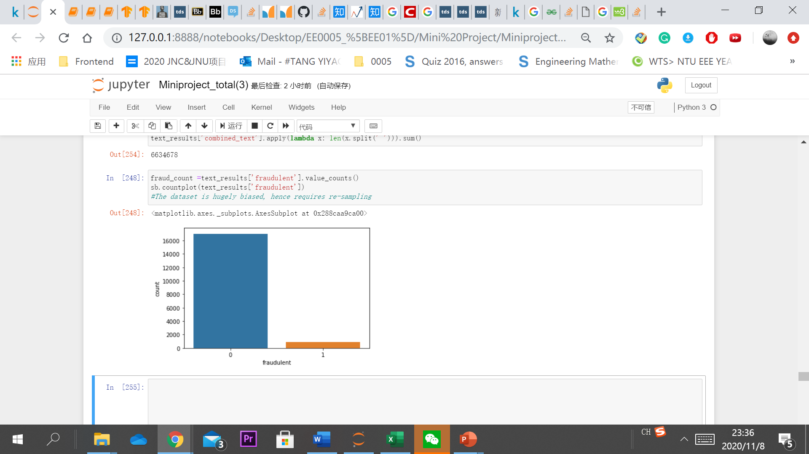

3
Tackling
Unbalanced Data
17014
866

Slide 31
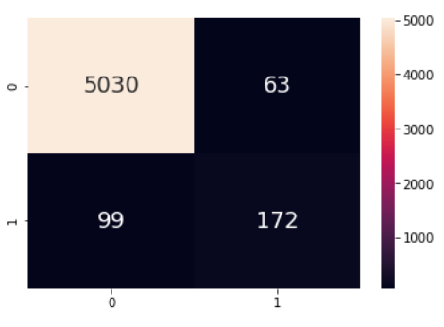
Risks of Imbalanced Data
Excellent overall accuracy
Underperformed when predicting the minority class
Accuracy: around 97%
But…
Misleading and undesirable
for data classification

Slide 32

Some resampling techniques:
A crucial step of data preprocessing

Slide 33
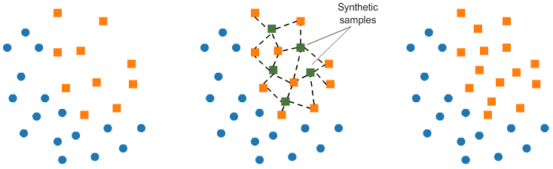
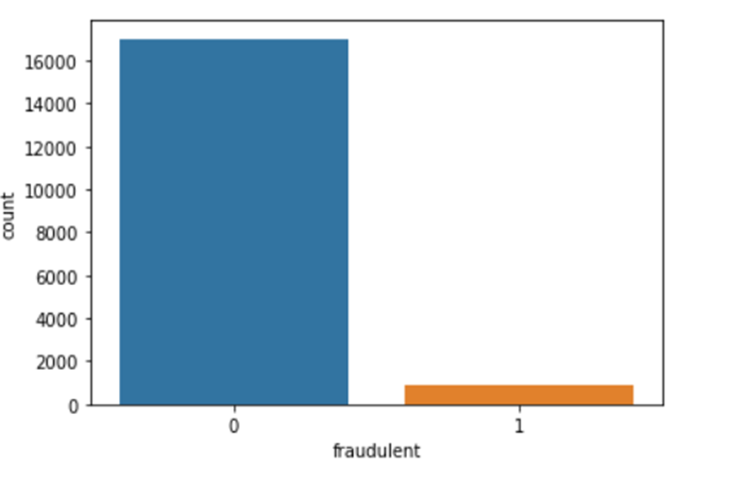
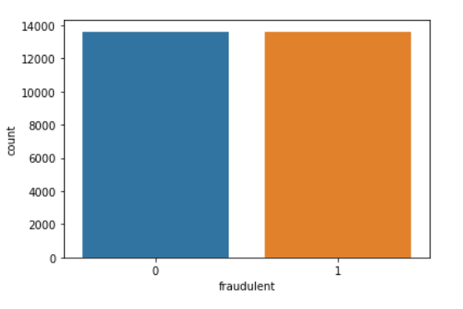
Over-sampling using SMOTE

Slide 34

After resampling:
More reliable
for predicting fake jobs!

Slide 35
Some innovative methods
we have tried:
Word Embeddings
Implemented by Doc2Vec
TF-IDF :bag-of-word to represent text features
Word embeddings: Word vectors for the text features
The contextual information remains intact when tokenizing the text, hence more accurate

Slide 36
Some NLP data cleaning techniques:
Tokenization
URL Extraction
Normalization
Uppercase to lowercase
Remove punctuation marks
Replace weblink with the title of the webpage…

Slide 37
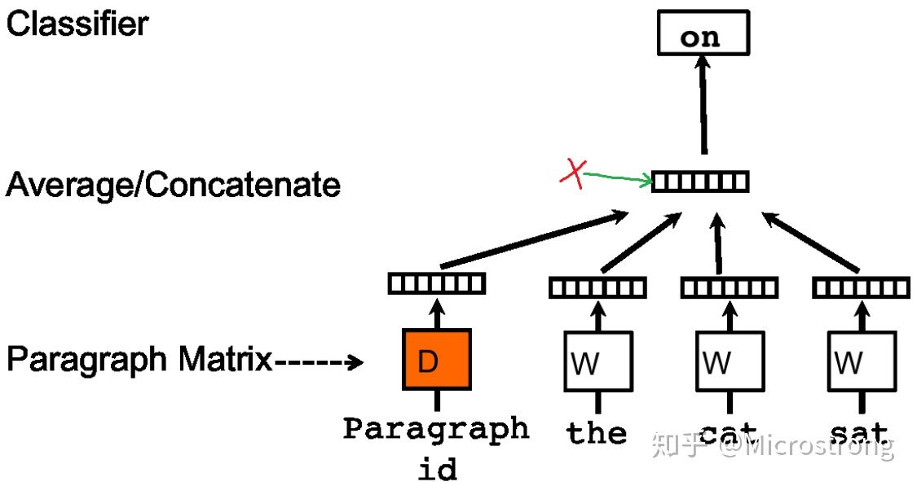
Visual representation of Doc2Vec models:
An analogy:
Convolutional Neural Network
Both use a kernel to scan through the neighboring data field to extract the structural information

Slide 38
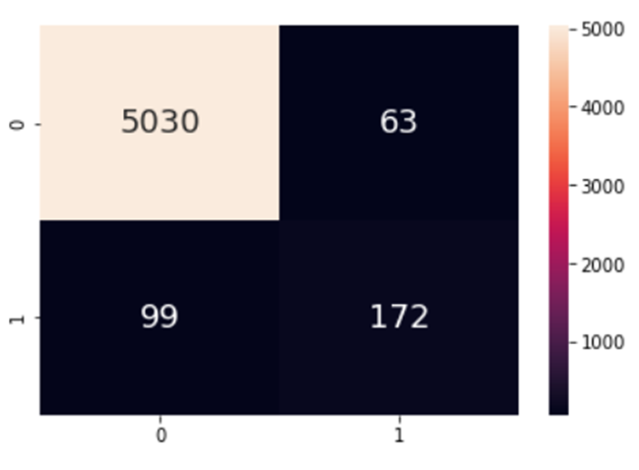
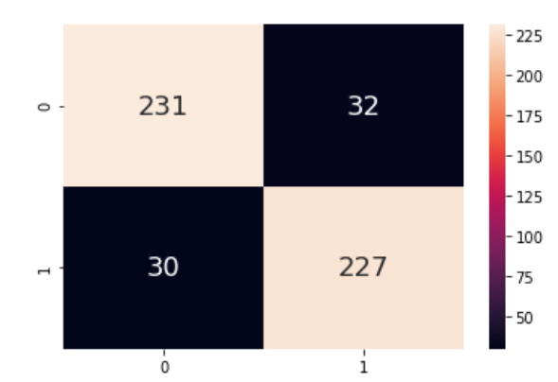
Comparison:
TF-IDF without resampling
TF-IDF with resampling
Word Embeddings:
False Positive Rate: 0.245
False Negative Rate: 0.030
F1 Score: 0.960
False Positive Rate: 0.125
False Negative Rate: 0.126
F1 Score: 0.875
Invalid

Slide 39
Reference
TFIDF：
https://www.youtube.com/watch?v=UvsQPsrZTK4&feature=youtu.be
https://blog.csdn.net/liuxuejiang158blog/article/details/31360765
https://stackoverflow.com/questions/62658215/convergencewarning-lbfgs-failed-to-converge-status-1-stop-total-no-of-iter
https://zhuanlan.zhihu.com/p/31197209
Logistic regression:
https://scikit-learn.org/stable/modules/generated/sklearn.linear_model.LogisticRegression.html
Neural Network:
https://keras.io/api/layers/
Word Embeddings:
https://radimrehurek.com/gensim/models/word2vec.html
https://www.tensorflow.org/tutorials/text/word2vec

Slide 40
THANKS
For Your Watching

